Slide 1
Adjacency list JSON – Both maze styles
JSON – Line-walled maze
JSON – Occupancy grid maze
{
"size": {
"columns": 3,
"rows": 3
},
"start": [
0,
0
],
"end": [
2,
2
],
"grid": [
[
{
"walls": {
"N": true,
"E": true,
"S": false,
"W": true
}
},
{
"size": {
"columns": 3,
"rows": 3
},
"start": [
0,
0
],
"end": [
2,
2
],
"grid": [
{
"node": [
0,
0
],
"neighbors": [
[
1,
0
]
]
},
{
"size": {
"columns": 7,
"rows": 7
},
"start": [
1,
1
],
"end": [
5,
5
],
"grid": [
[
1,
1,
1,
1,
1,
1,
1
],

Slide 2
General Response Layout
General Reasoning Process
Introduce task
Introduce task
Algorithm
Algorithm
Choose method
Choose method
Heuristics
Heuristics
Try to solve maze
Try to solve maze
If struggling
Language expressing frustration
If struggling
If not struggling
(Summarize)
Concluding remark
Reverse search
Change method
If not struggling
Change method
Language expressing frustration
Restart
Restart
using the same method
using a different method:
algorithm, heuristics, reverse search
(Validate)
(Summarize)

Slide 3
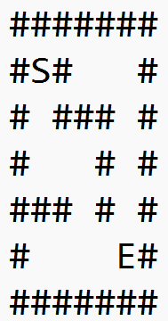
Tokenized – Line-walled maze
Tokenized – Occupancy grid maze
<|0-0|> <|uprightleft_wall|> <|origin|>
<|0-1|> <|updownleft_wall|> …
<|2-2|> <|downright_wall|> <|target|>
<|0-0|> <|occupied_wall|> … <|1-1|> <|origin|>
<|1-2|> <|occupied_wall|> <|1-3|> <|blank|> …
<|5-5|> <|target|> … <|6-6|> <|occupied_wall|>
ASCII – Occupancy grid maze
Adjacency list text – Both maze styles
<ADJLIST_START> (1,1) <–> (2,1) ; … (5,4) <–> (5,5) <ADJLIST_END> <ORIGIN_START>(1,1)<ORIGIN_END> <TARGET_START>(5,5)<TARGET_END>

Slide 4
JSON – Line-walled maze
{
"size": {
"columns": 3,
"rows": 3
},
"start": [
0,
0
],
"end": [
2,
2
],
"grid": [
[
{
"walls": {
"N": true,
"E": true,
"S": false,
"W": true
}
},
Only line-walled
Tokenized – Line-walled maze
<|0-0|> <|uprightleft_wall|> <|origin|>
<|0-1|> <|updownleft_wall|> …
<|2-2|> <|downright_wall|> <|target|>

Slide 5
Adjacency list JSON – Both maze styles
{
"size": {
"columns": 3,
"rows": 3
},
"start": [
0,
0
],
"end": [
2,
2
],
"grid": [
{
"node": [
0,
0
],
"neighbors": [
[
1,
0
]
]
},
Only occupancy
Tokenized – Occupancy grid maze
<|0-0|> <|occupied_wall|> … <|1-1|> <|origin|>
<|1-2|> <|occupied_wall|> <|1-3|> <|blank|> …
<|5-5|> <|target|> … <|6-6|> <|occupied_wall|>
ASCII – Occupancy grid maze

Slide 6
{
"size": {
"columns": 3,
"rows": 3
},
"start": [
0,
0
],
"end": [
2,
2
],
"grid": [
[
{
"walls": {
"N": true,
"E": true,
"S": false,
"W": true
}
},
JSON – Line-walled maze
JSON – Occupancy grid maze
Adjacency list JSON – Both maze styles
Adjacency list text – Both maze styles
{
"size": {
"columns": 7,
"rows": 7
},
"start": [
1,
1
],
"end": [
5,
5
],
"grid": [
[
1,
1,
1,
1,
1,
1,
1
],
{
"size": {
"columns": 3,
"rows": 3
},
"start": [
0,
0
],
"end": [
2,
2
],
"grid": [
{
"node": [
0,
0
],
"neighbors": [
[
1,
0
]
]
},
<ADJLIST_START> (1,1) <–> (2,1) ; … (5,4) <–> (5,5) <ADJLIST_END> <ORIGIN_START>(1,1)<ORIGIN_END> <TARGET_START>(5,5)<TARGET_END>
Tokenized – Line-walled maze
<|0-0|> <|uprightleft_wall|> <|origin|>
<|0-1|> <|updownleft_wall|> …
<|2-2|> <|downright_wall|> <|target|>
Tokenized – Occupancy grid maze
<|0-0|> <|occupied_wall|> … <|1-1|> <|origin|>
<|1-2|> <|occupied_wall|> <|1-3|> <|blank|> …
<|5-5|> <|target|> … <|6-6|> <|occupied_wall|>
ASCII – Occupancy grid maze

Slide 7
JSON – Line-walled maze
JSON – Occupancy grid maze
Adjacency list JSON – Both maze styles
Adjacency list text – Both maze styles
{
"size": {
"columns": 3,
"rows": 3
},
"start": [
0,
0
],
"end": [
2,
2
],
"grid": [
[
{
"walls": {
"N": true,
"E": true,
"S": false,
"W": true
}
},
{
"size": {
"columns": 7,
"rows": 7
},
"start": [
1,
1
],
"end": [
5,
5
],
"grid": [
[
1,
1,
1,
1,
1,
1,
1
],
{
"size": {
"columns": 3,
"rows": 3
},
"start": [
0,
0
],
"end": [
2,
2
],
"grid": [
{
"node": [
0,
0
],
"neighbors": [
[
1,
0
]
]
},
<ADJLIST_START> (1,1) <–> (2,1) ; … (5,4) <–> (5,5) <ADJLIST_END> <ORIGIN_START>(1,1)<ORIGIN_END> <TARGET_START>(5,5)<TARGET_END>
Tokenized – Line-walled maze
<|0-0|> <|uprightleft_wall|> <|origin|>
<|0-1|> <|updownleft_wall|> …
<|2-2|> <|downright_wall|> <|target|>
Tokenized – Occupancy grid maze
<|0-0|> <|occupied_wall|> … <|1-1|> <|origin|>
<|1-2|> <|occupied_wall|> <|1-3|> <|blank|> …
<|5-5|> <|target|> … <|6-6|> <|occupied_wall|>
ASCII – Occupancy grid maze

Slide 8
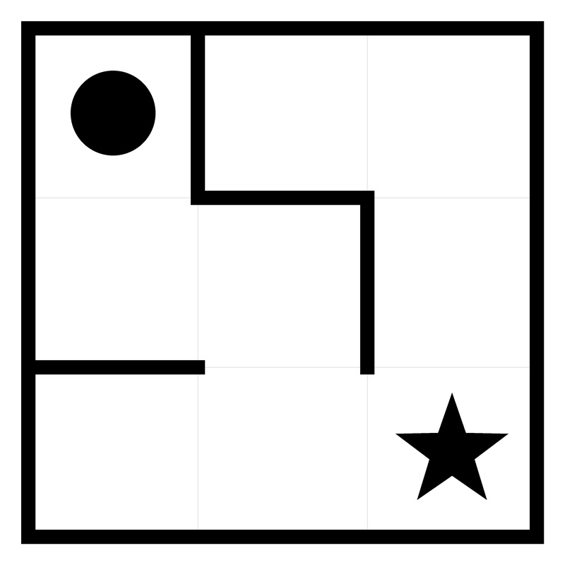
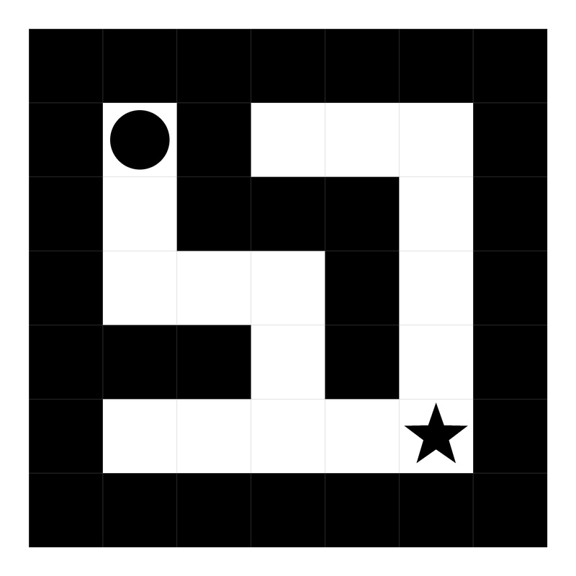
JSON
Adjacency List JSON
Adjacency List Text
Tokenized
ASCII
JPG
{
"size": {
"columns": 3,
"rows": 3
},
"start": [
0,
0
],
"end": [
2,
2
],
"grid": [
[
{
"walls": {
"N": true,
"E": true,
"S": false,
"W": true
}
},
{
"size": {
"columns": 3,
"rows": 3
},
"start": [
0,
0
],
"end": [
2,
2
],
"grid": [
{
"node": [
0,
0
],
"neighbors": [
[
1,
0
]
]
},
<ADJLIST_START> (1,1) <–> (2,1) ;
… (5,4) <–> (5,5) <ADJLIST_END> <ORIGIN_START>(1,1)<ORIGIN_END> <TARGET_START>(5,5)<TARGET_END>
<|0-0|> <|uprightleft_wall|> <|origin|>
<|0-1|> <|updownleft_wall|> …
<|2-2|> <|downright_wall|> <|target|>
None
Line-Walled Maze
{
"size": {
"columns": 7,
"rows": 7
},
"start": [
1,
1
],
"end": [
5,
5
],
"grid": [
[
1,
1,
1,
1,
1,
1,
1
],
{
"size": {
"columns": 3,
"rows": 3
},
"start": [
0,
0
],
"end": [
2,
2
],
"grid": [
{
"node": [
0,
0
],
"neighbors": [
[
1,
0
]
]
},
<ADJLIST_START> (1,1) <–> (2,1) ;
… (5,4) <–> (5,5) <ADJLIST_END> <ORIGIN_START>(1,1)<ORIGIN_END> <TARGET_START>(5,5)<TARGET_END>
<|0-0|> <|occupied_wall|> … <|1-1|> <|origin|>
<|1-2|> <|occupied_wall|> <|1-3|> <|blank|> …
<|5-5|> <|target|> … <|6-6|> <|occupied_wall|>
Occupancy Grid Maze

